Slide 1
Pipelining w/ Azure
Markus Winkler
Cloud & DevOps Architect, 10/21/2020

Slide 2
Azure DevOps
Azure DevOps provides developer services to support teams to plan work, collaborate on code development, and build and deploy applications.
Combines Repos, Pipelines, Project planning boards, Artifact store under one hood

Slide 3
Azure DevOps Organization
With an organization, you gain access to the platform
Collaborate with others to develop applications by using our cloud service
Plan and track your work and code defects and issues
Set up continuous integration and deployment
Integrate with other services by using service hooks
Obtain additional features and extensions
Create one or more projects to segment work.

Slide 4
Azure DevOps Organization
DevOps Organization
Project One
Repos
Pipelines
Azure Services
Artifacts

Slide 5
Azure DevOps Organization
DevOps Organization
Project One
Repos
Project Two
Repos
Azure Services
Pipelines
Pipelines
Azure Services
Artifacts
Artifacts

Slide 6
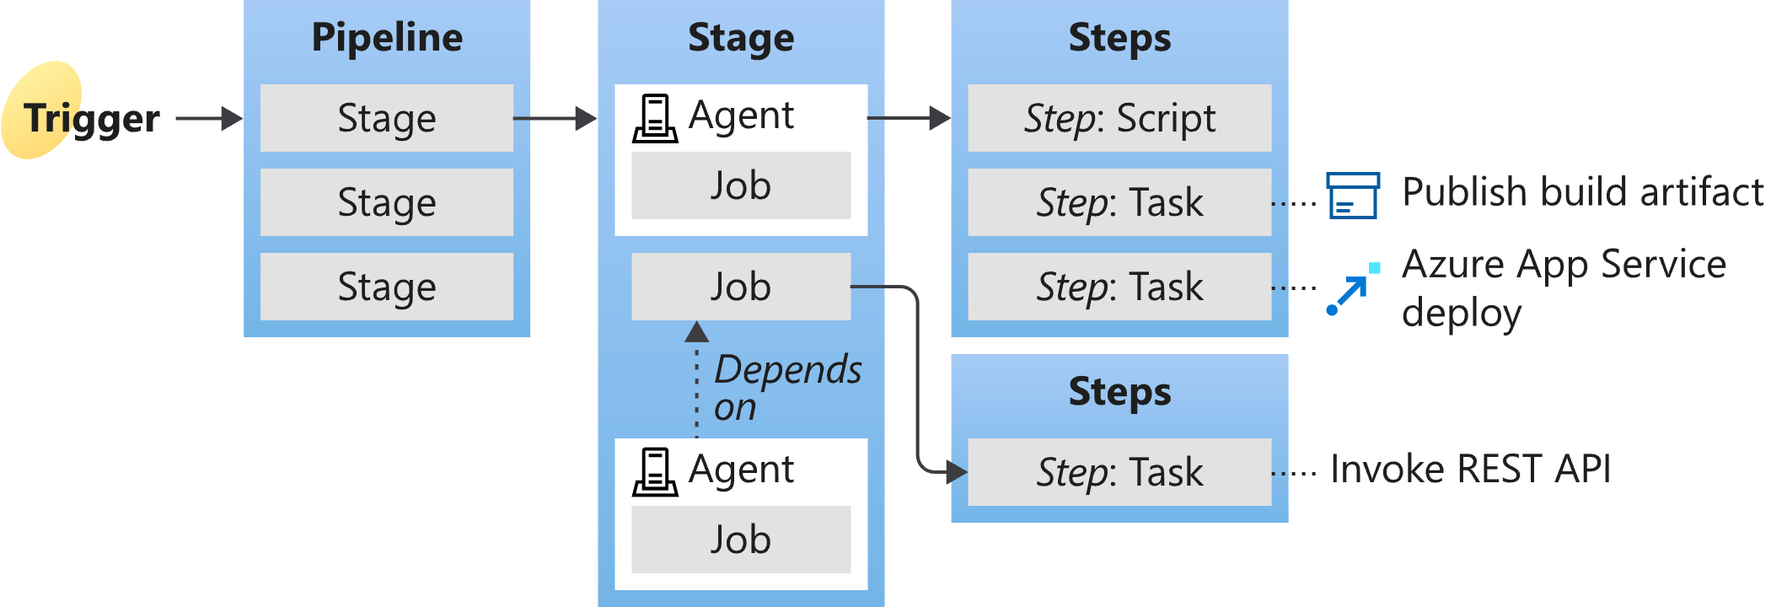
Azure Pipelines

Slide 7
Azure Pipeline uses azure-pipelines.yml
trigger:
- master
resources:
- repo: self
variables:
dockerRegistryServiceConnection: 'f3b74647-1710-4aa0-abfc-4da499cbc745'
imageRepository: 'cappsecuploader'
containerRegistry: 'c1appsecuploaderregistry2.azurecr.io'
dockerfilePath: '**/Dockerfile'
tag: '$(Build.BuildId)'
imagePullSecret: 'c1appsecuploaderregistry2f127-auth'
# Agent VM image name
vmImageName: 'ubuntu-latest'

Slide 8
Azure Pipeline uses azure-pipelines.yml
stages:
- stage: Build
displayName: Build stage
jobs:
- job: Build
displayName: Build
pool:
vmImage: $(vmImageName)
steps:
- task: Docker@2
displayName: Build and push an image
inputs:
command: buildAndPush
repository: $(imageRepository)
dockerfile: $(dockerfilePath)
containerRegistry: $(dockerRegistryServiceConnection)
tags: $(tag)
- upload: manifests
artifact: manifests

Slide 9
Azure Pipeline uses azure-pipelines.yml
- stage: Deploy
displayName: Deploy stage
dependsOn: Build
jobs:
- deployment: Deploy
displayName: Deploy
pool:
vmImage: $(vmImageName)
environment: 'mawinklerc1appsecuploader-1012.appcluster-default-1871‘
strategy:
runOnce:
deploy:
steps:
- task: KubernetesManifest@0
displayName: Create imagePullSecret
...
- task: KubernetesManifest@0
displayName: Deploy to Kubernetes cluster
...

Slide 10
Smart Check in azure-pipelines.yml
within stage Build
split task buildAndPush
build
scan
push
stages:
- stage: Build
jobs:
- job: Build
displayName: Build
pool:
vmImage: $(vmImageName)
steps:
- task: Docker@2
displayName: Build an image
inputs:
command: build
- script: |
SmartCheckScanAction
...
- task: Docker@2
displayName: Push an image
inputs:
command: push

Slide 11
Azure Container Registry
ACR is a fully-managed container registry
Supports image scanning on push, recently pulled and on import
Aka Azure Defender for Container Registries
Powered by Qualys

Slide 12
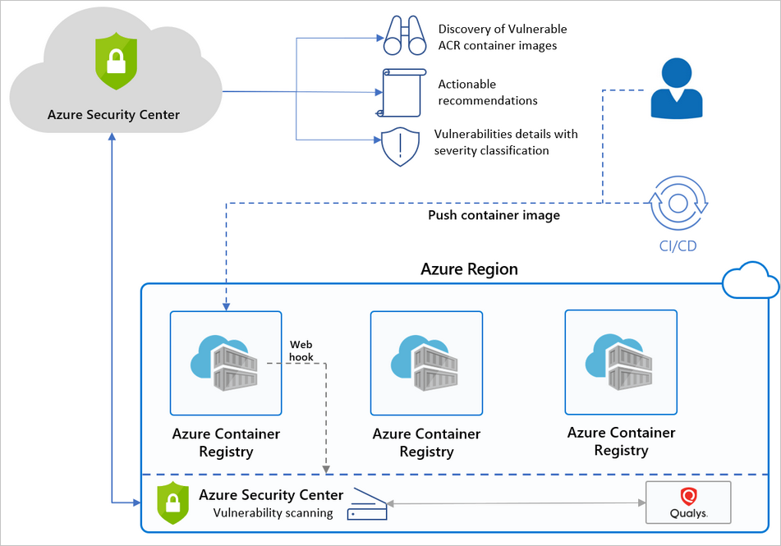
Azure Container Registry

